Slide 1


Metal Usage in Ancient Protein Domains
Nandini Manepalli, Sawsan Wehbi, Joanna Masel
Arizona NASA Space Grant Student Research Symposium
April 19, 2025

Slide 2
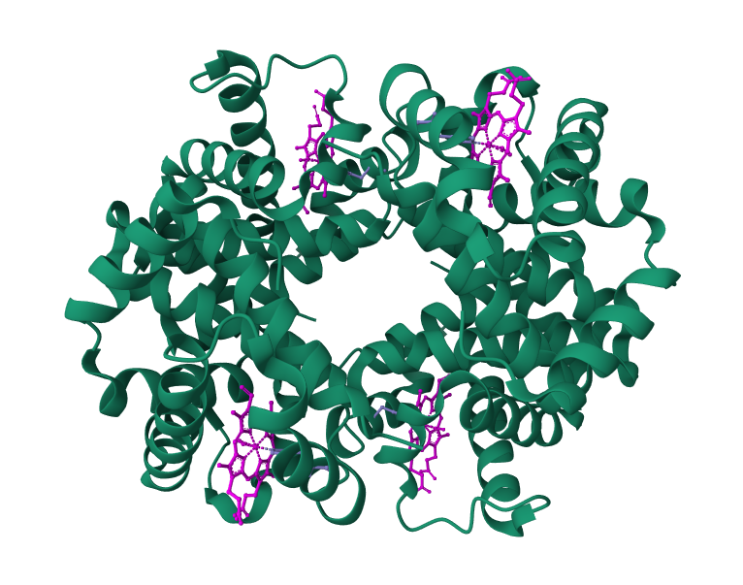
Metalloproteins
Almost half of all proteins bind metals, and are known as metalloproteins
Catalyze biochemical reactions
Many metalloproteins date back to the Last Universal Common Ancestor (LUCA)
LUCA: Community of organisms from which all life on Earth is believed to have been descended from
HEME groups bound to hemoglobin protein

Slide 3

What metals were used more often by ancient proteins compared to proteins that emerged more recently?
Allows us to understand the metal bioavailability and environmental conditions conducive to the origins of life on Earth
Aid in our search for life elsewhere in the universe

Slide 4
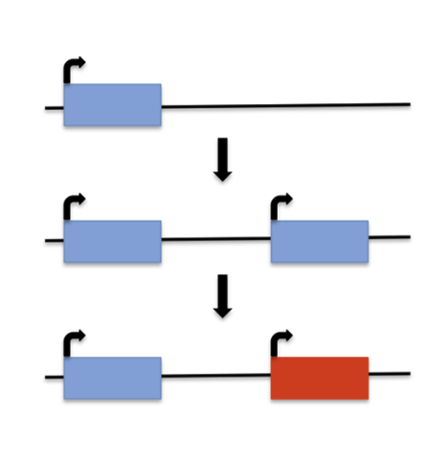
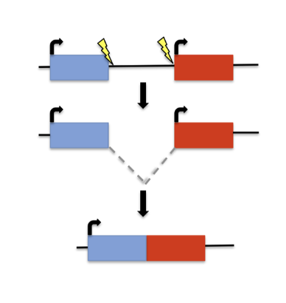
Genes are born at different times
Not all genes emerged at the dawn of life
Some genes emerged de novo (from noncoding regions)
Some genes evolve from pre-existing genes
Gene 1
Gene 2
Gene 1
Gene 1
Gene 1 copy
Gene 1
New gene
New gene
Gene Duplication
Gene Fusion

Slide 5
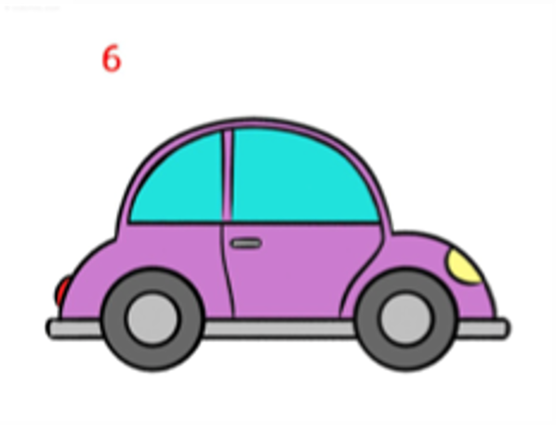

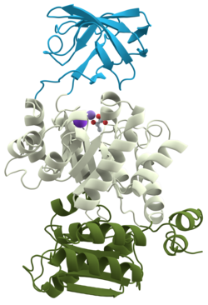
Protein domains
Domains: basic units of proteins that can fold, function, and evolve independently
Akin to a wheel (domain) that is a part of the larger car (protein)
Domain 1
Many proteins consist of multiple domains
Each potentially varying in evolutionary age
Domain 2
Domain 3

Slide 6
Protein domains
Wehbi et. al (2024) previously classified protein domains based on their age group via phylogenetic reconstruction
Each age group reflects a unique geochemical environment on ancient Earth
Archaea
LUCA
Last Universal Common Ancestor
Bacteria

Slide 7
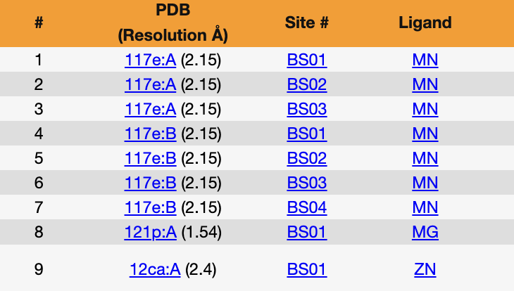
Data collection and analysis
Metal binding protein domains were annotated using the BioLiP and PDBfam databases
BioLiP contains info about locations of metal binding sites in proteins and what metal(s) they are associated with
PDBfam contains info about regions of domains in proteins
For each protein:
Checked if binding site was located within the domain
What metal(s) the domain binds to
Snapshot of BioLiP Database

Slide 8
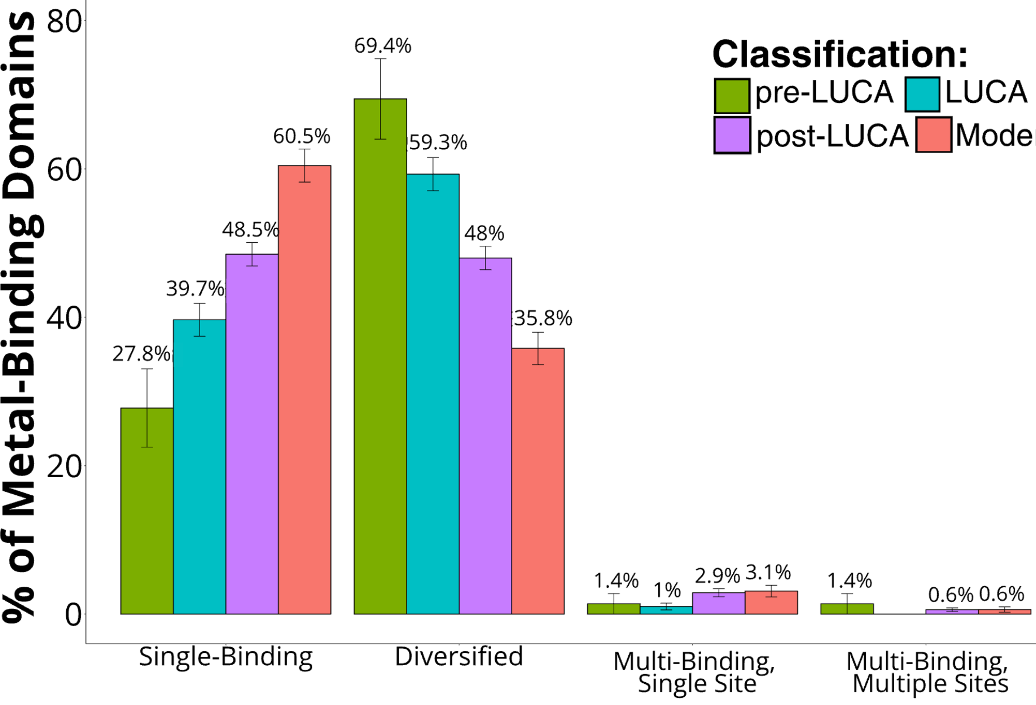
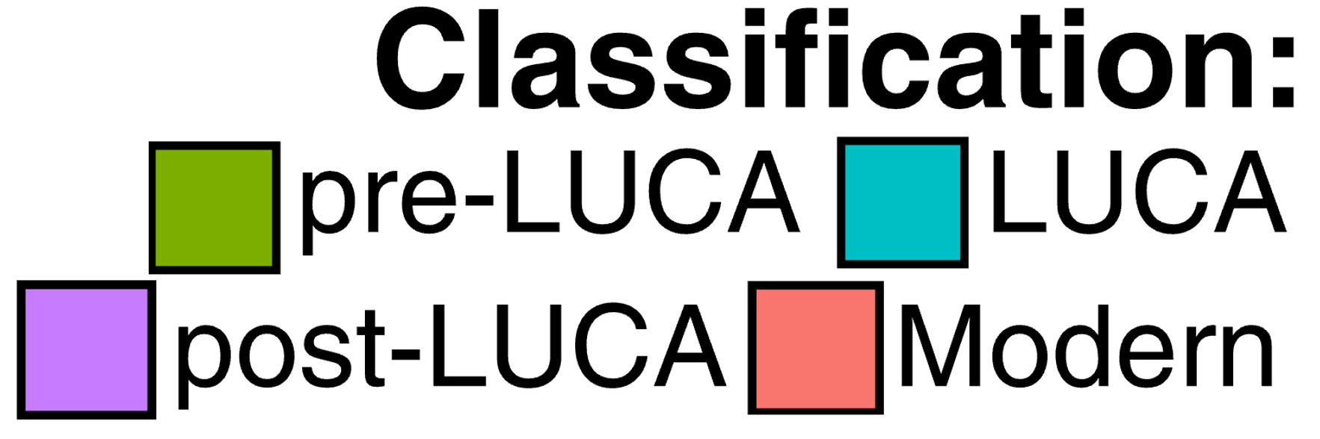
Complication: Ancient domains have had more time to diversify into binding different metals
Promiscuous
Simultaneous
Domains that only bind one metal
Domains that bind different metals in different proteins
Domains that bind one of multiple metals at the same binding site
Domains that bind multiple metals at different binding sites

Slide 9
Complication: Ancient domains have had more time to diversify into binding different metals
For now, we assume equiprobability of ancestral states
Promiscuous
Simultaneous
Domains that only bind one metal
Domains that bind different metals in different proteins
Domains that bind one of multiple metals at the same binding site
Domains that bind multiple metals at different binding sites

Slide 10
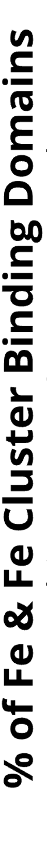
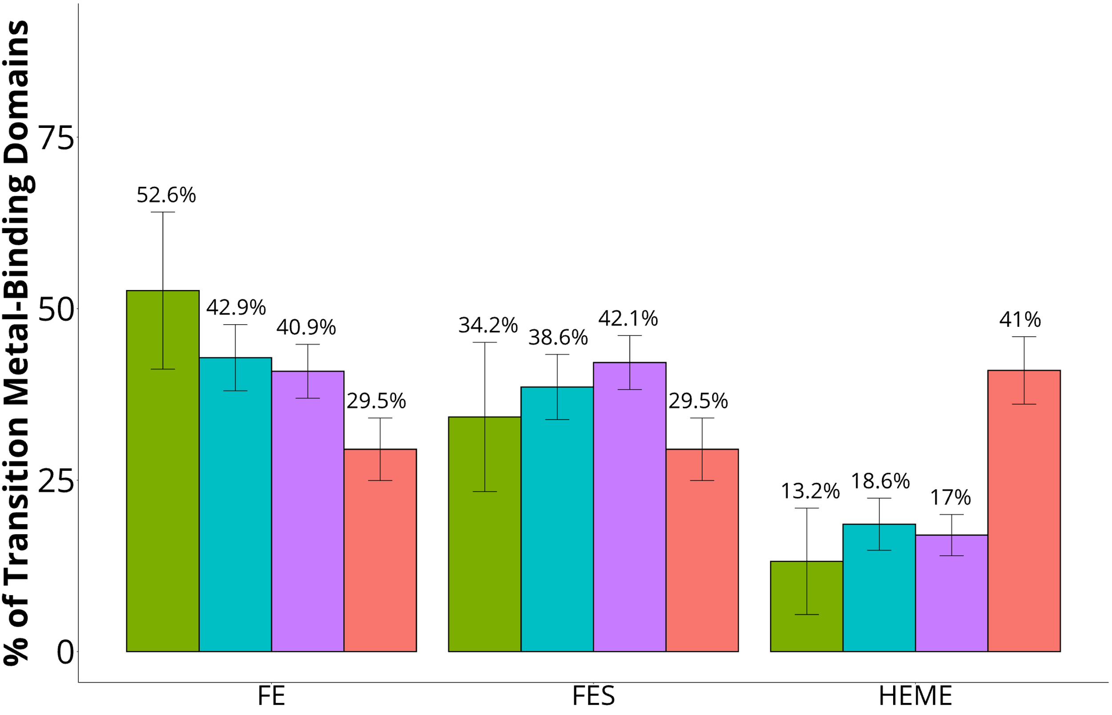
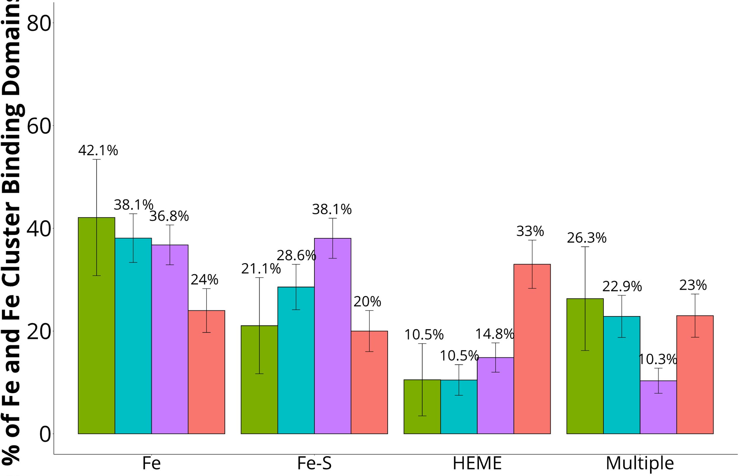
Older domains are more likely to bind to iron cations directly, younger domains via heme groups

Slide 11
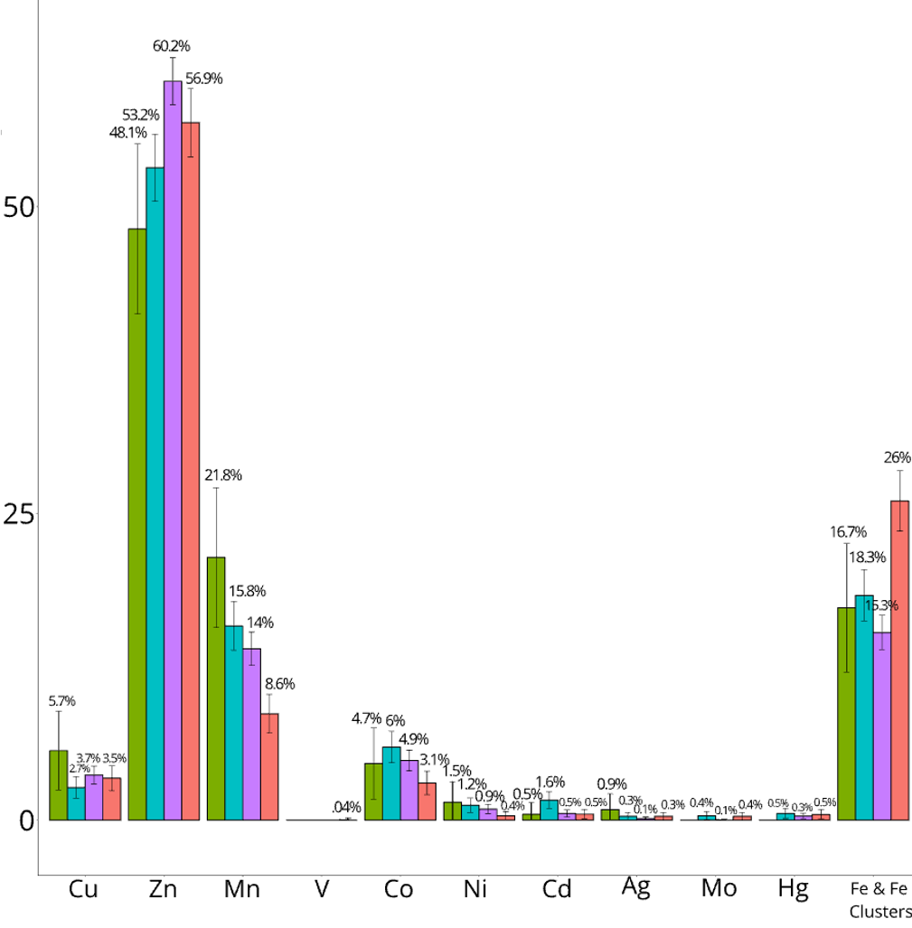
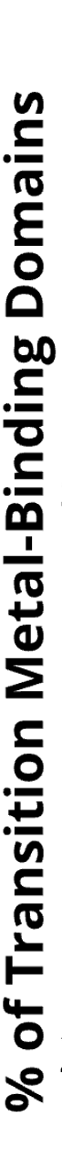
Ancient domains used more manganese, which makes sense in an anaerobic world
Ancient domains use manganese more often than younger domains

Slide 12
Ongoing work
Using comparative phylogenetic methods to infer the ancestral state of domains that bind multiple metals
Fe
Fe
?
Zn
What metal did this domain bind first?
Fe

Slide 13
Ongoing work
Using comparative phylogenetic methods to infer the ancestral state of domains that bind multiple metals
Fe
Fe
Zn
This domain likely bound to Iron first!
Fe

Slide 14
Ongoing work
Using comparative phylogenetic methods to infer the ancestral state of domains that bind multiple metals
Fe
Fe
Zn
This domain likely bound to Iron first!
Fe
Currently reconstructing trees for domains; new trees will be used for ancestral state reconstruction

Slide 15
Conclusions
Metal usage trends:
Ancient domains are more likely to bind to iron cations directly, younger domains via heme groups
Ancient domains more likely to bind to manganese than younger domains
Older domains have diversified into binding multiple metals
Ongoing work focuses on inferring the ancestral state of domains that bind multiple metals

Slide 16
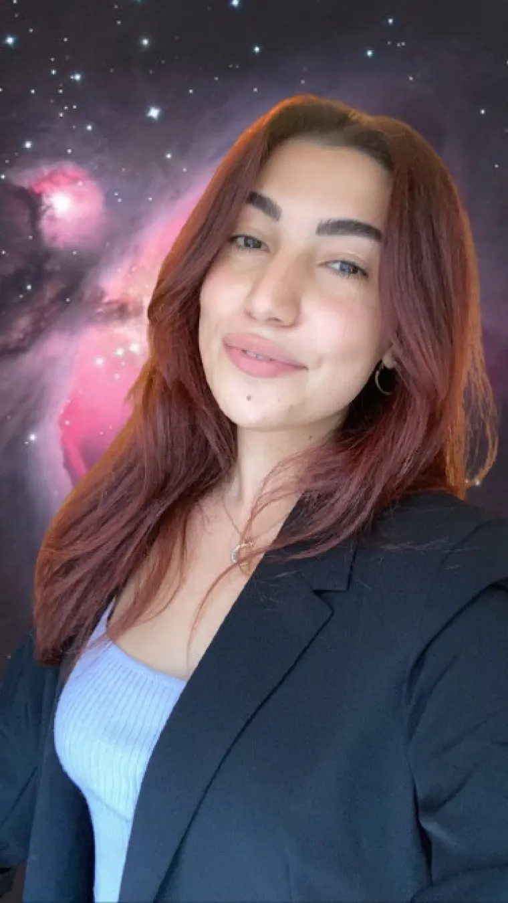
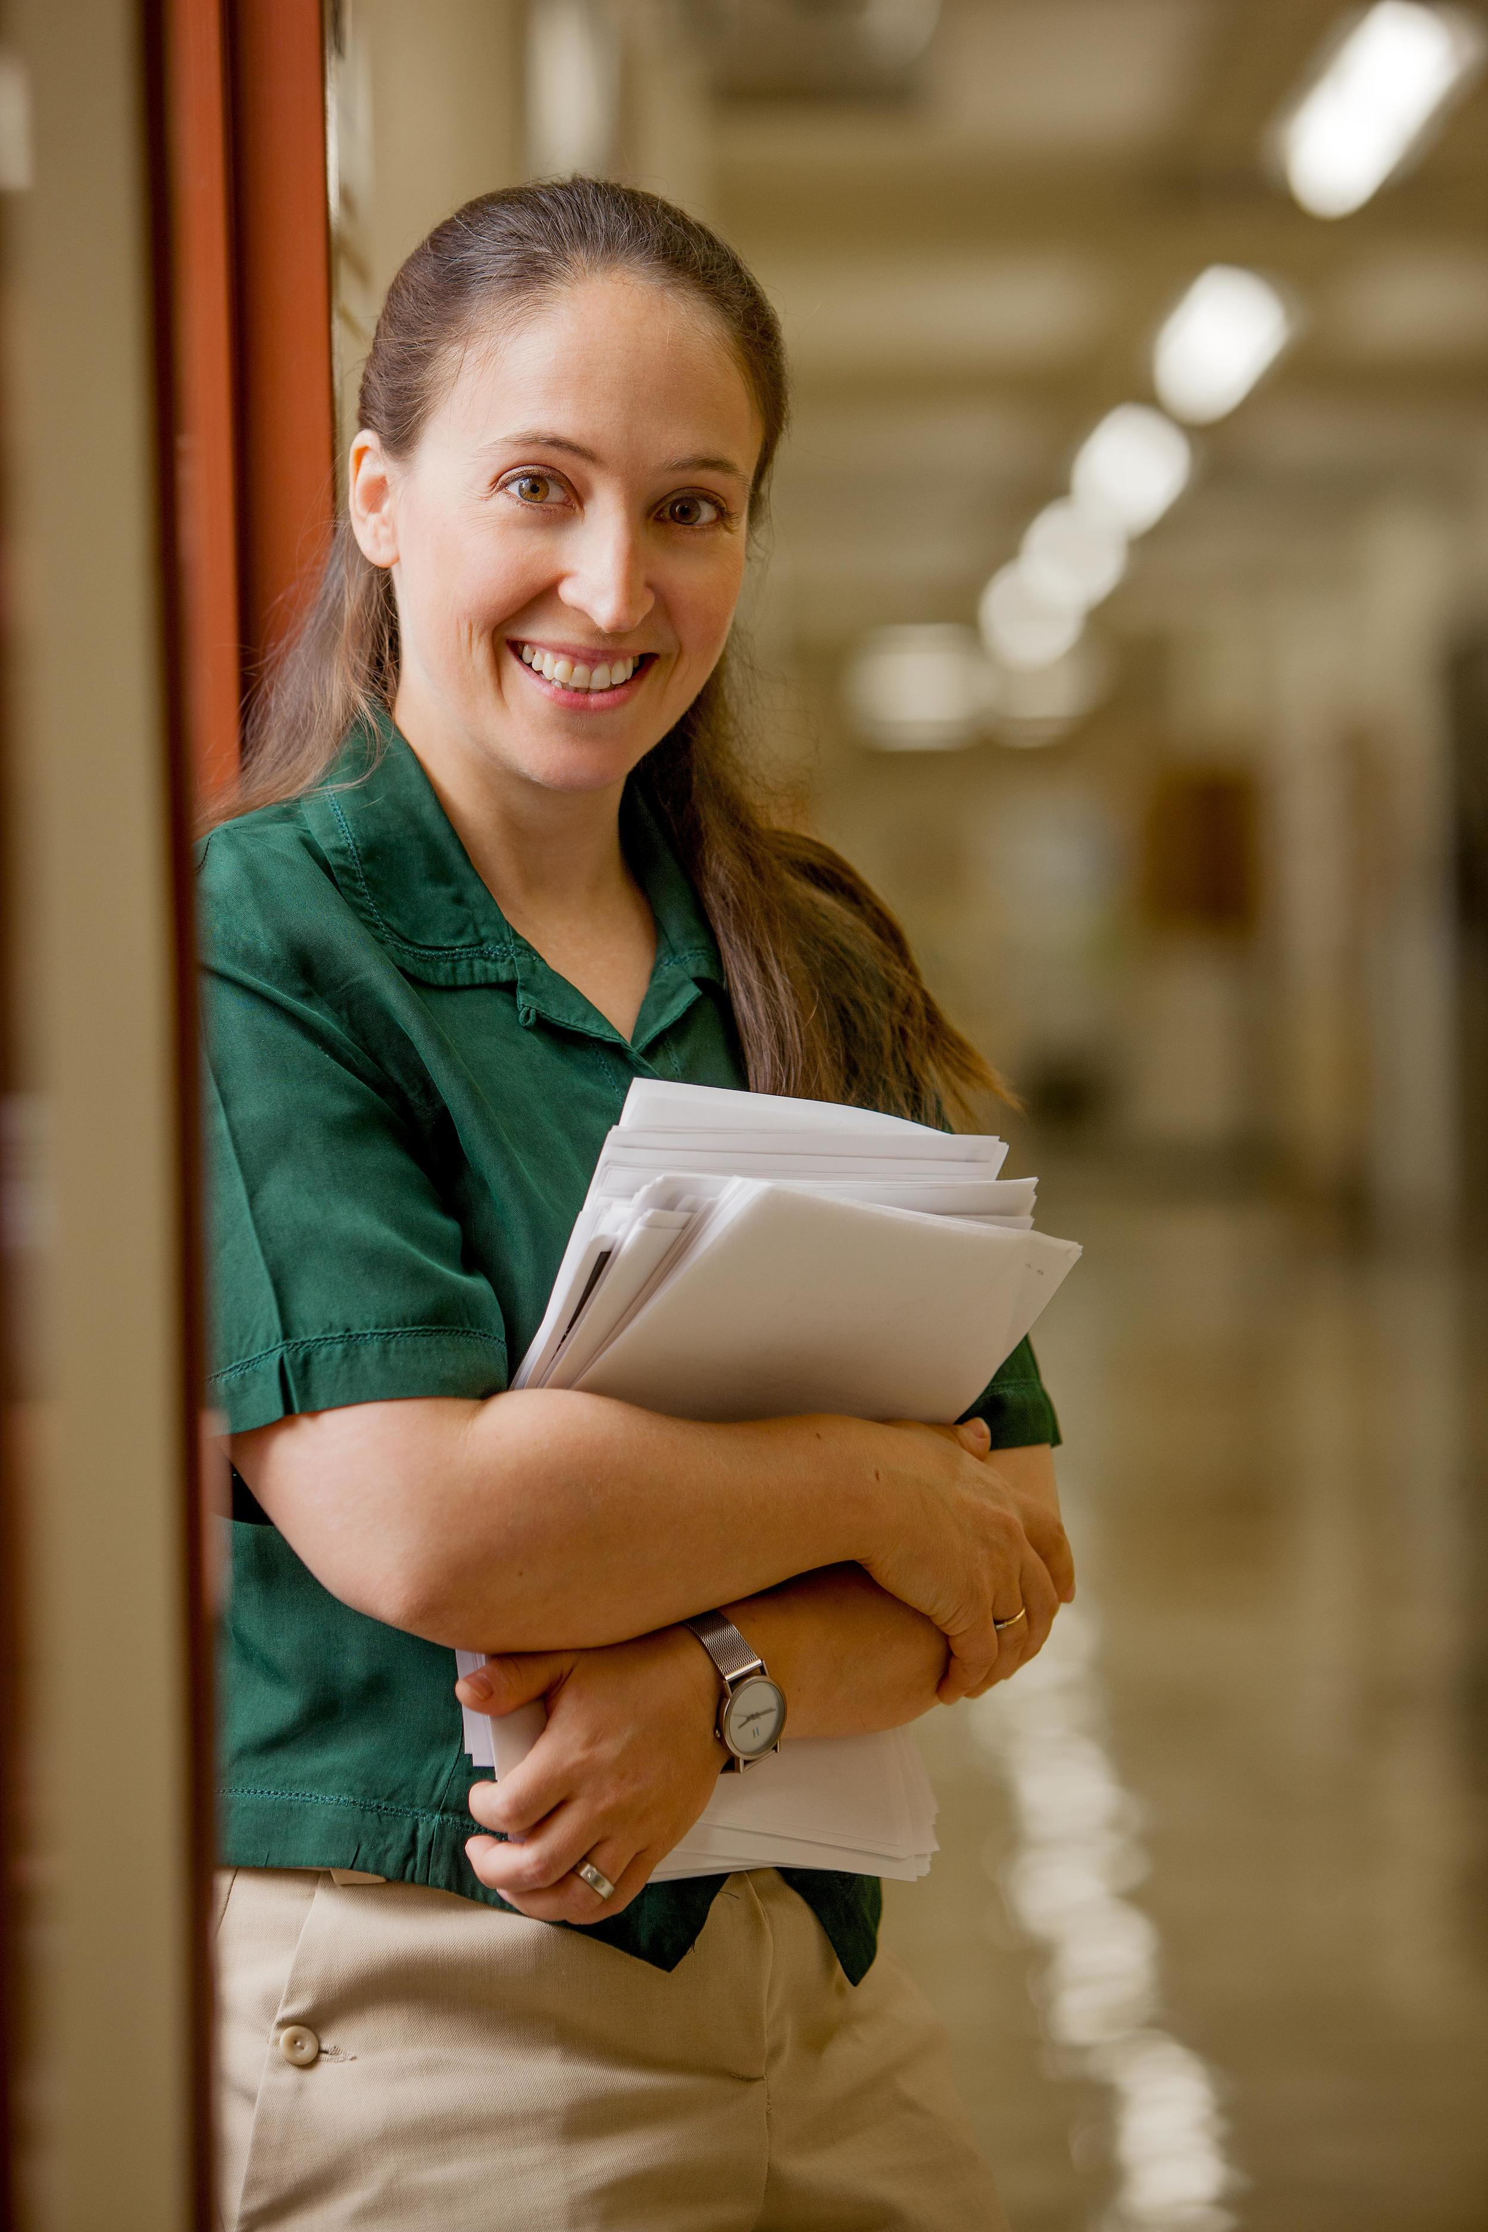



Acknowledgements
Sawsan
Wehbi
Joanna Masel
Andrew Wheeler

Slide 17
Thank you!

